Slide 1
Lariat Strategic Planning
Dionne Watson

Slide 2
Purpose
Review 2018 revenue data & expenses
Discuss strategies for increasing revenue & reducing costs
Propose recommendations for 2019 Fiscal year

Slide 3
2018 Lariat Revenue Data
Target Audience: Ages 30 - 59

Slide 4
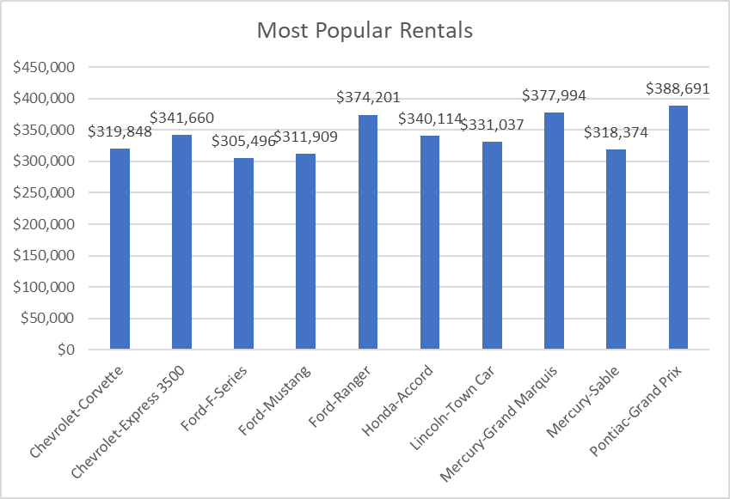
Strategy 1
Increase the inventory of the Top 10 revenue earners by 25% (equally distributed across Top 10 models)

Slide 5
2018 & Strategy 1 Predictions

Slide 6
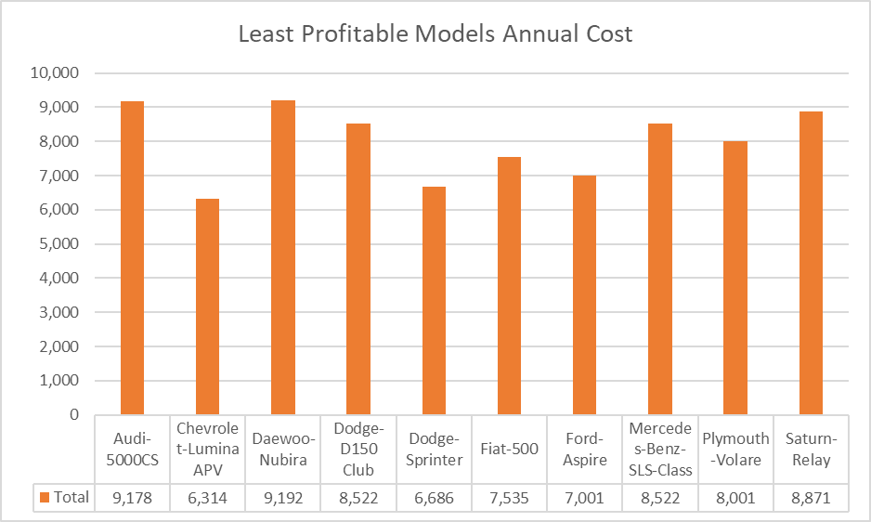
Strategy 2
Eliminate the least profitable models to reduce company costs

Slide 7
2018, Strategy 1 & Strategy 2 Predictions

Slide 8
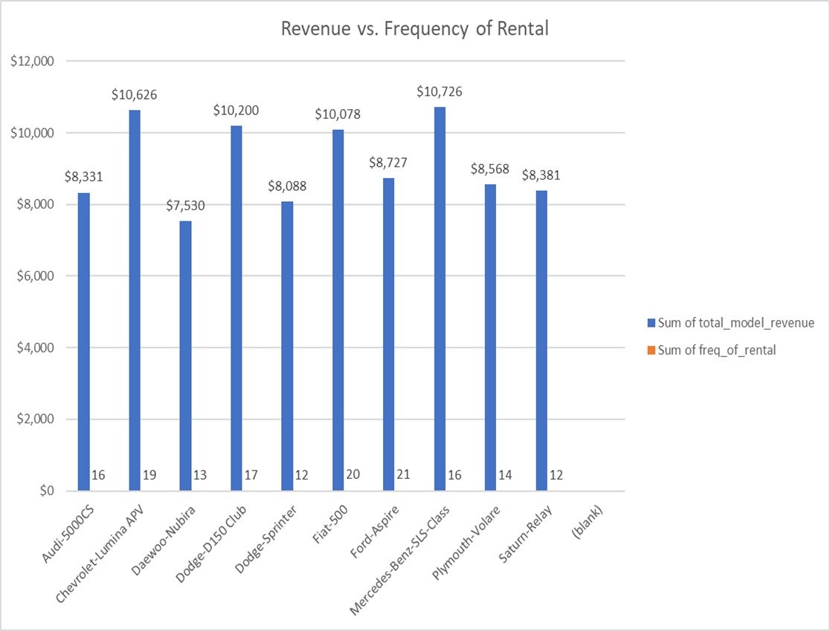
Strategy 3
Eliminate the models with fewer than 50 rentals from the company inventory.

Slide 9
Lariat Summary

Slide 10
Recommendations
Increase Top 10 revenue earners by 25%
Increase inventory by 1000 vehicles, 100 per model, 2 per branch
Eliminate least profitable models from inventory
Reduce costs by $80,000
Eliminate models with less than 50 rentals from inventory
Reduce costs by $2.5M

Slide 11
Any Questions?

